Slide 1
A Gentle Introduction to NN and DNN

Slide 2
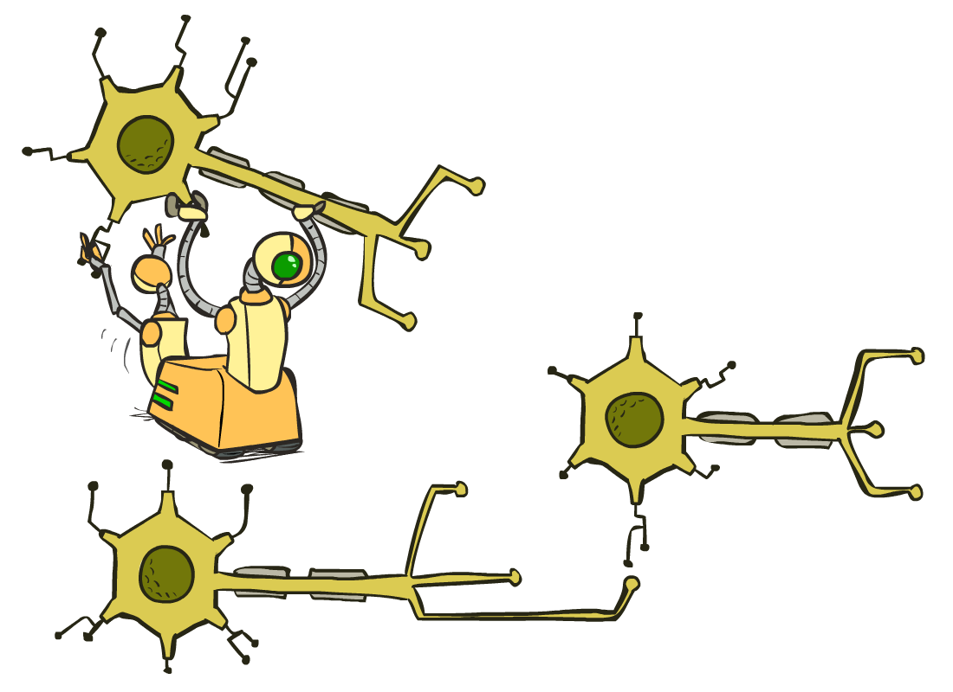
Neural Nets

Slide 3
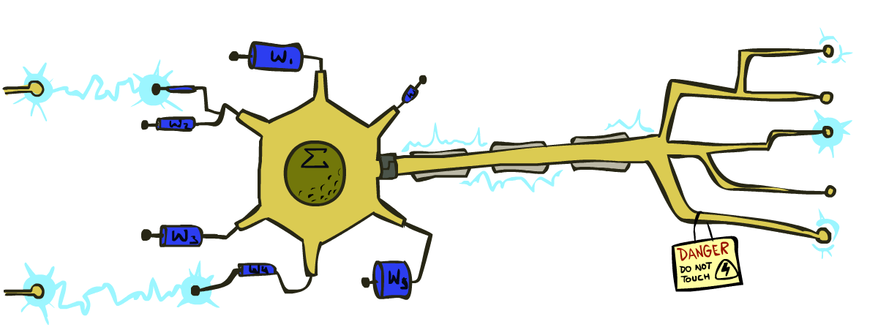
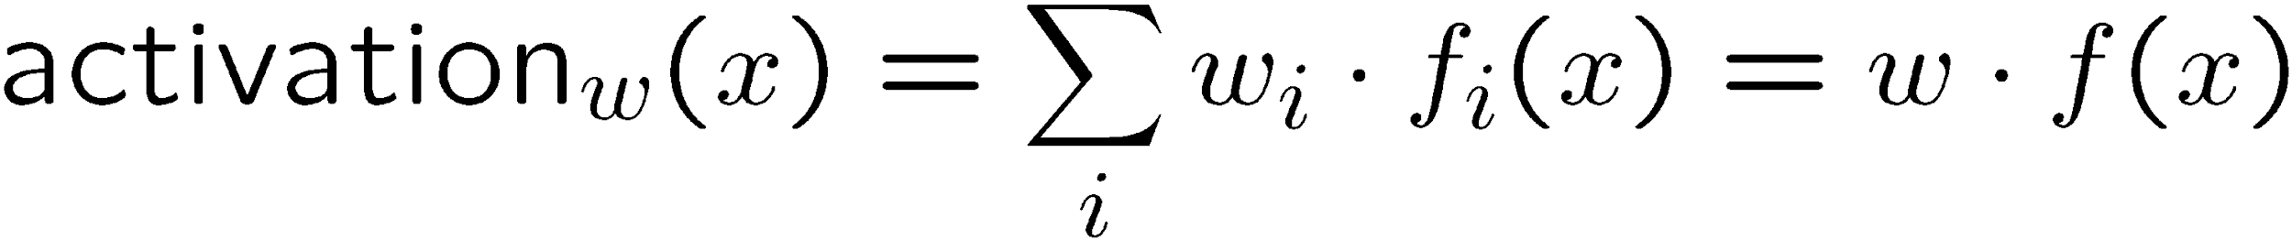
Reminder: Linear Classifiers
Inputs are feature values
Each feature has a weight
Sum is the activation
If the activation is:
Positive, output +1
Negative, output -1
w₁
f₁
Σ
w₂
>0?
f₂
w₃
f₃

Slide 4
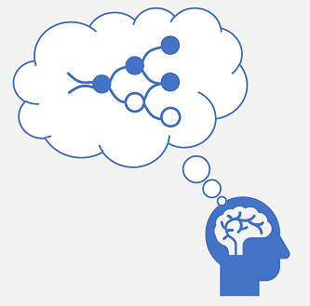
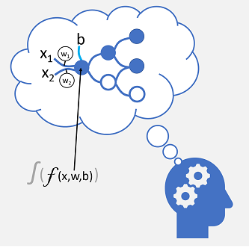
Biological vs Artificial NN

Slide 5
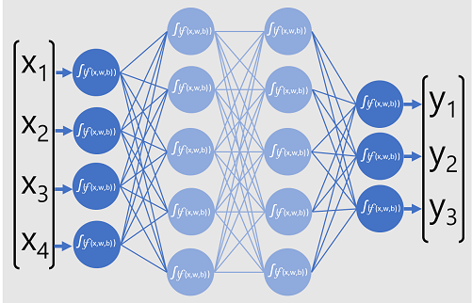
Neural networks
Syn:
MLP
FFNN
Dense Network
NN

Slide 6
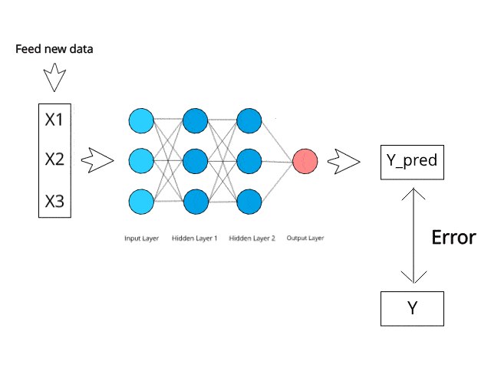
NN training

Slide 7
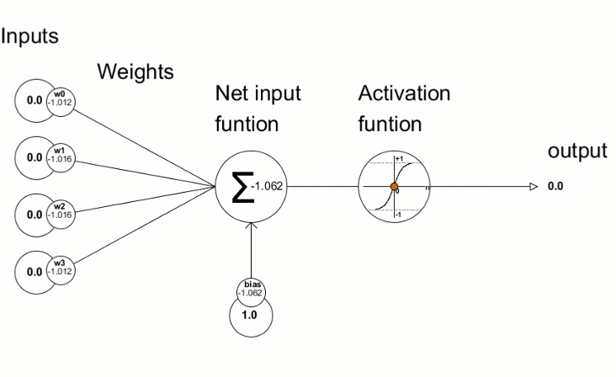
NN training

Slide 8
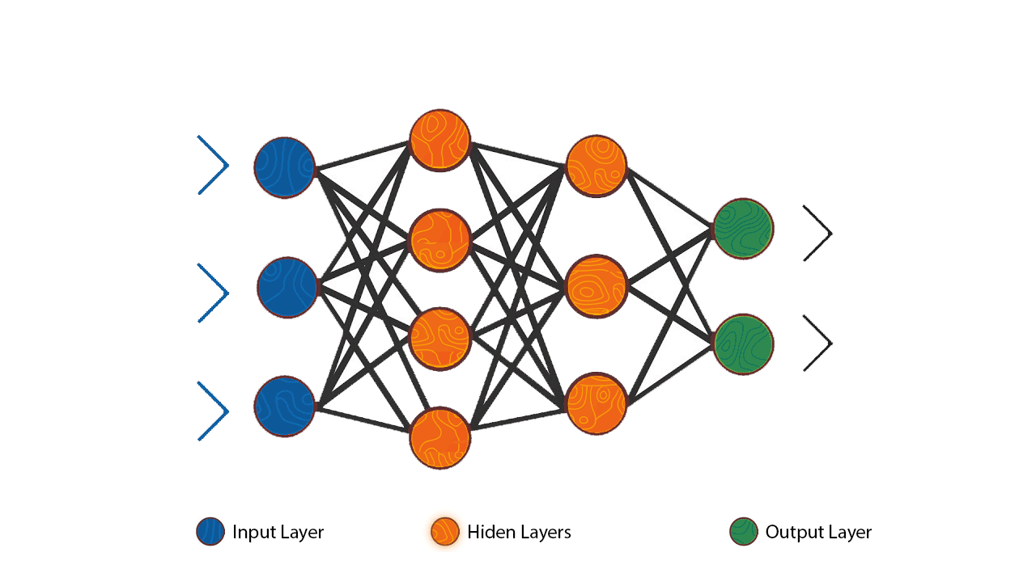

Slide 9
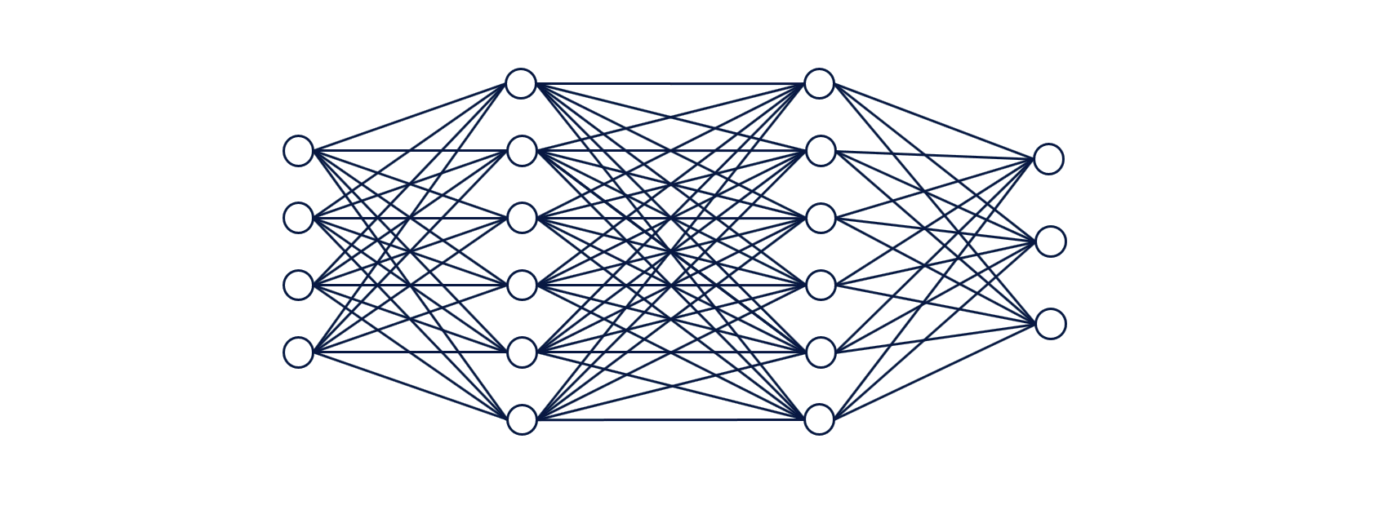
NN Classification

Slide 10


Slide 11
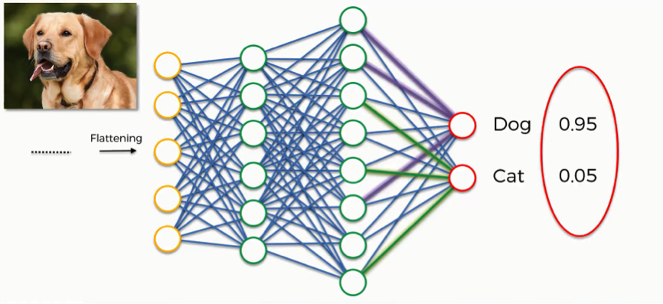

Slide 12


Slide 13
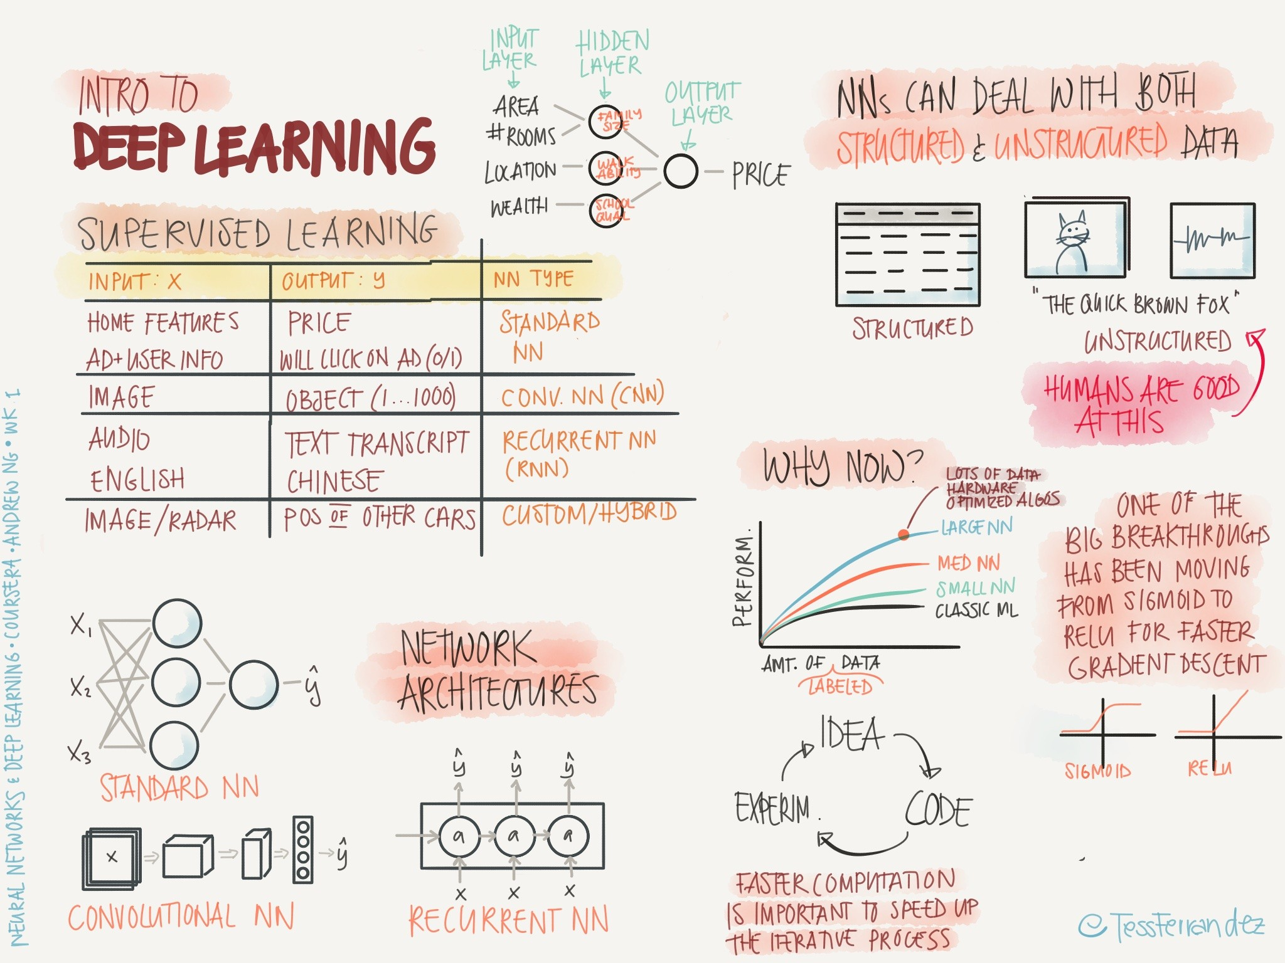

Slide 14

Why deep learning now?
Feature extraction
Performance

Slide 15
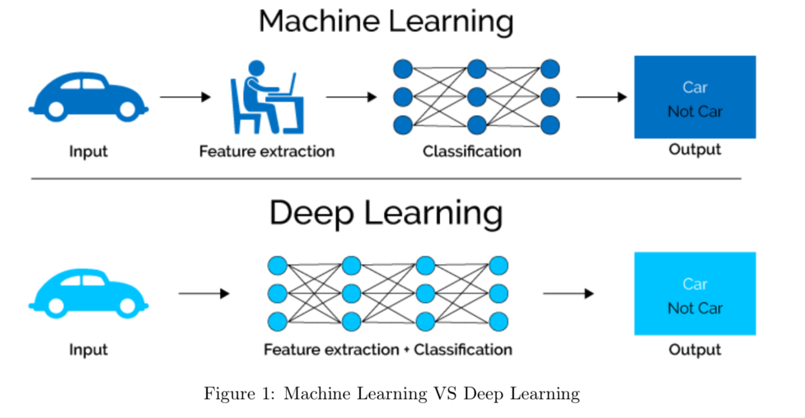
Feature extraction

Slide 16
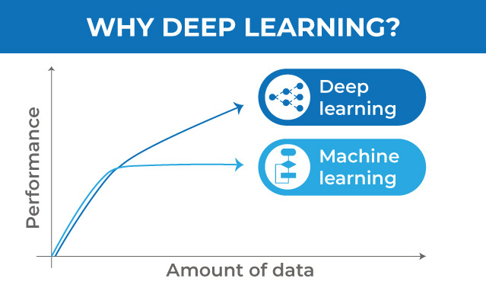
Performance

Slide 17
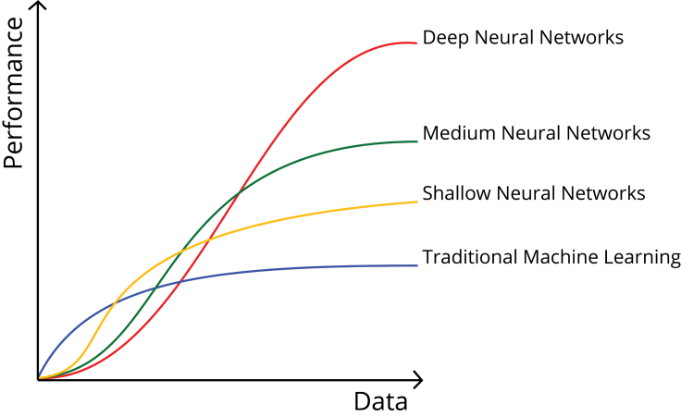
Performance

Slide 18
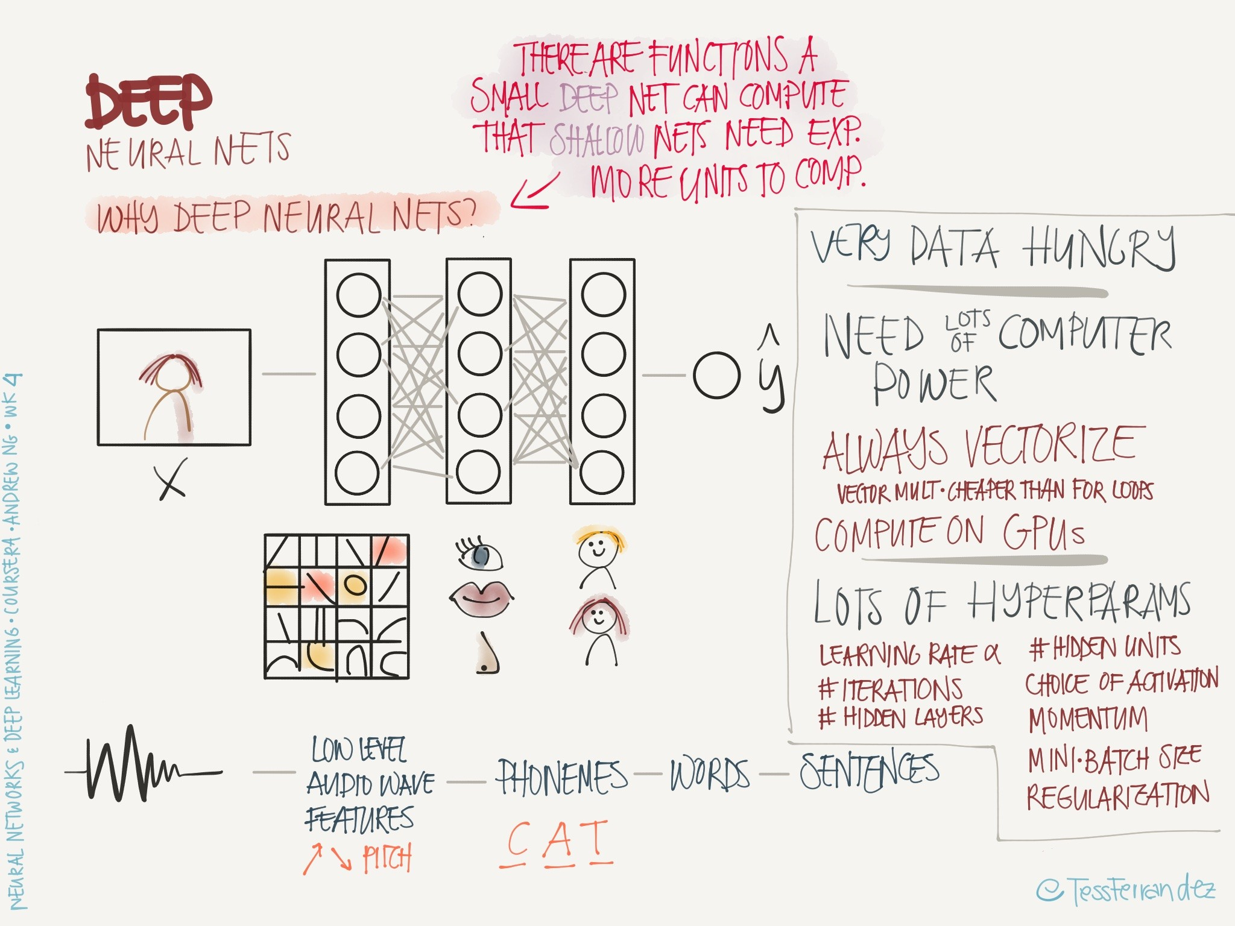

Slide 19
CNN

Slide 20

Convolution Operations

Slide 21
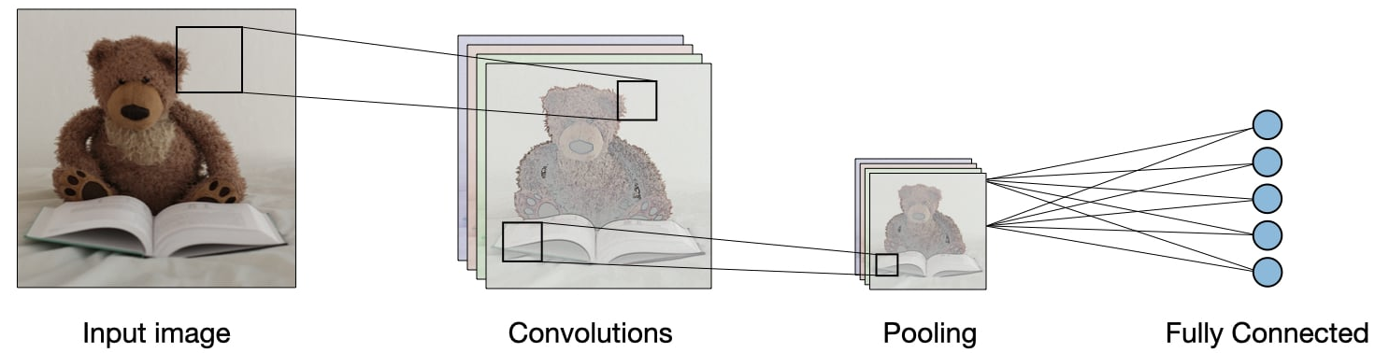
CNN

Slide 22
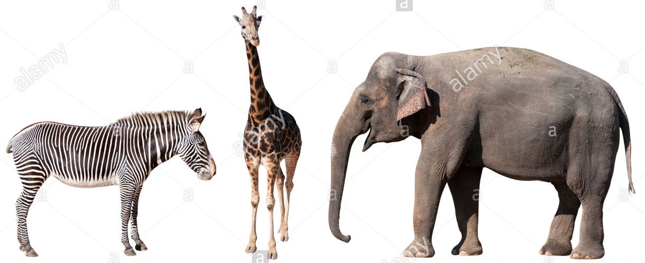
Image classification

Slide 23
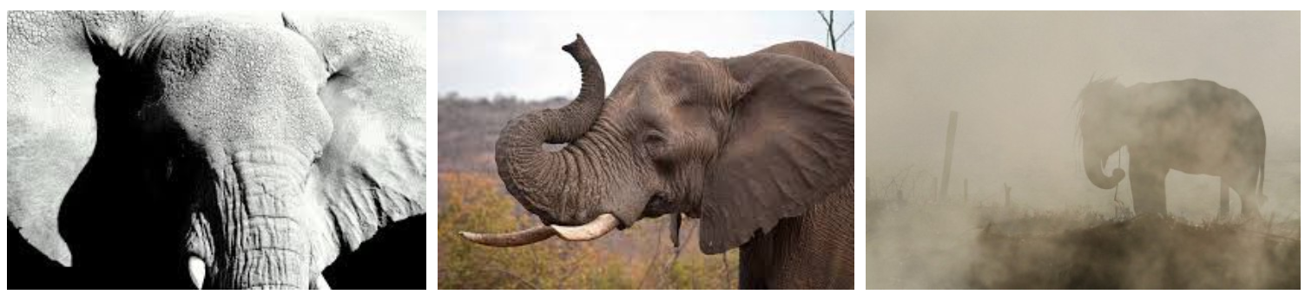
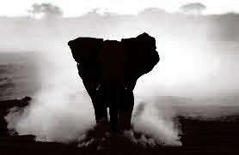
Elephant?

Slide 24
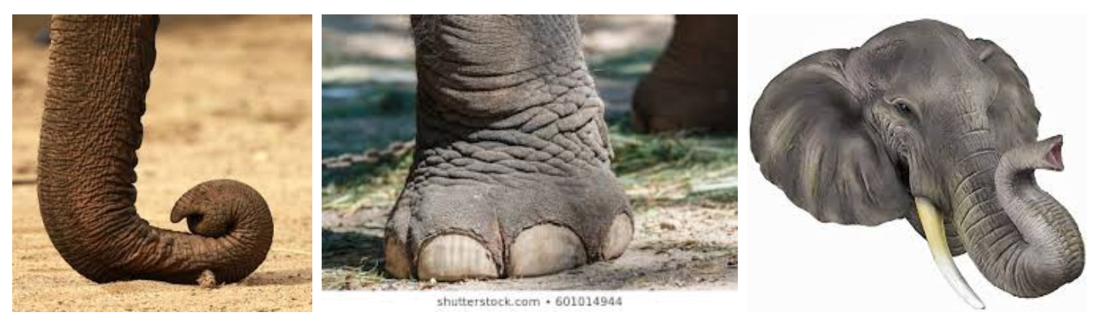
Elephant shape

Slide 25
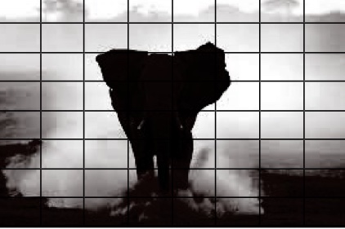
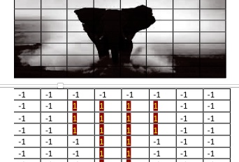
Shape matrix

Slide 26
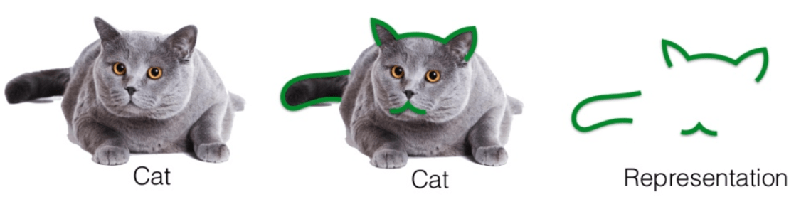

Cat shape

Slide 27
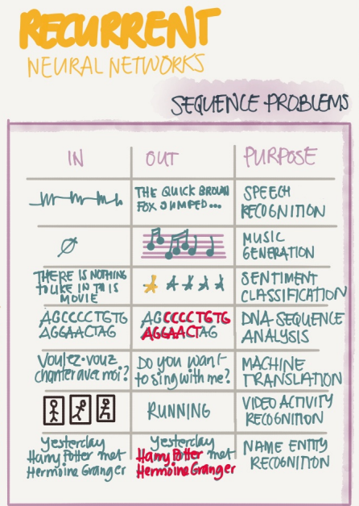
RNN

Slide 28
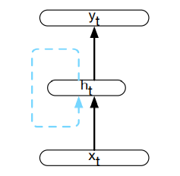
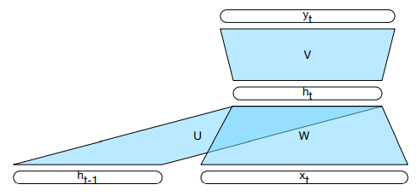
RNN
RNN

Slide 29
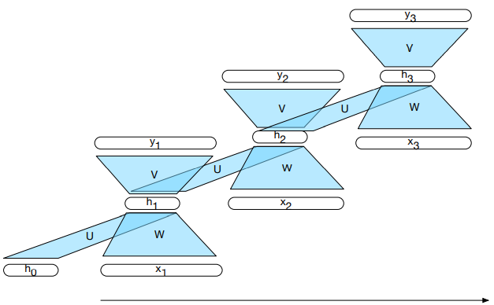
A simple recurrent neural network shown unrolled in time.

Slide 30
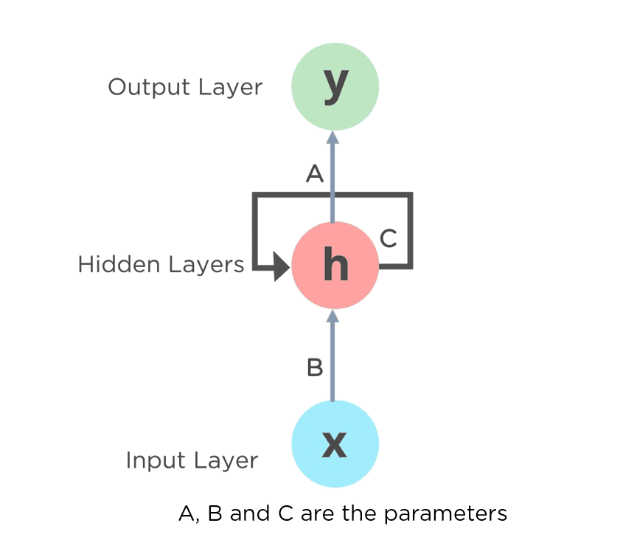

Slide 31


Slide 32
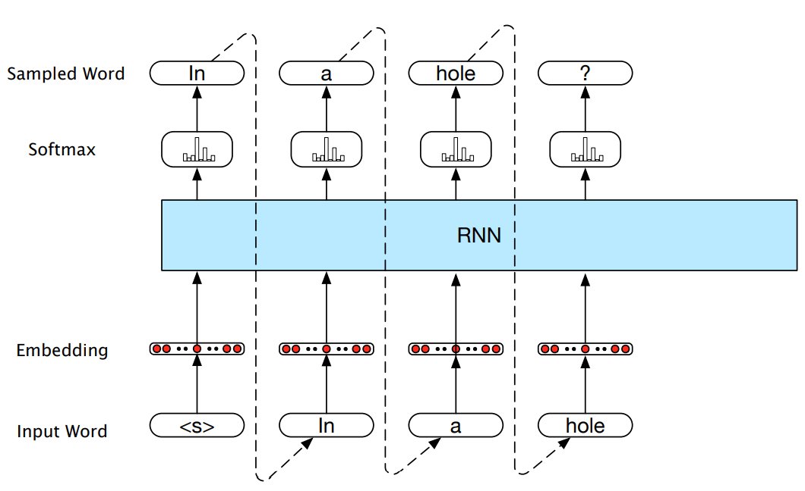
Autoregressive generation with an RNN-based neural language model

Slide 33
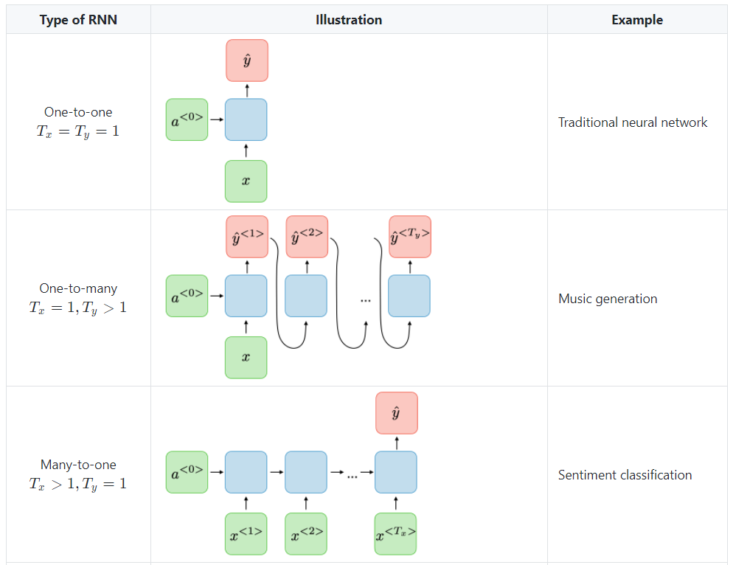
Types of RNN

Slide 34
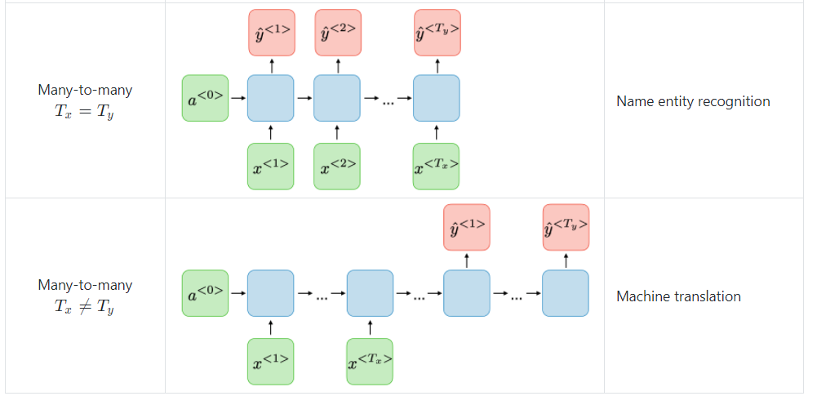
Types of RNN

Slide 35
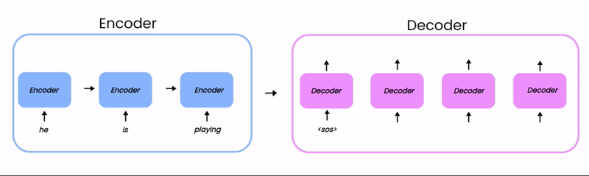
Encoder – Decoder MT

Slide 36
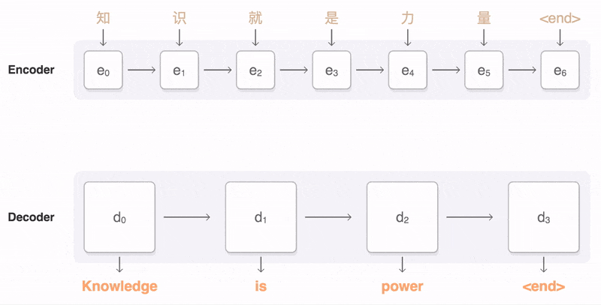
Attention

Slide 37
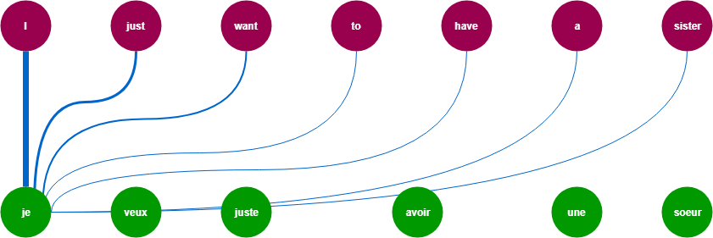
Attention

Slide 38


Questions ☺
Thanks for attention

